Slide 1
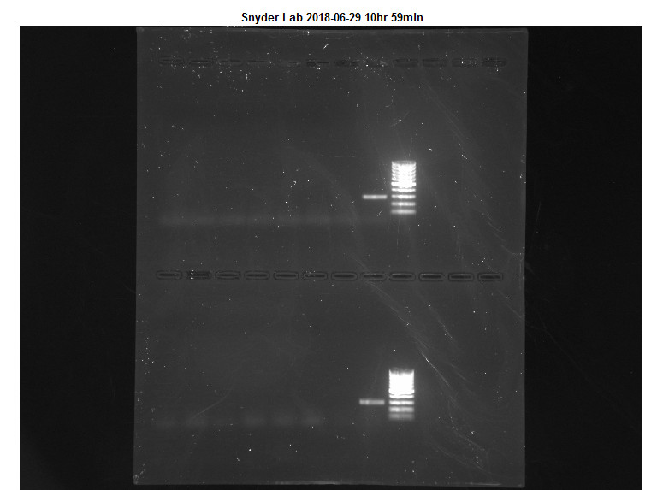
KEY:
HG1 ? (SC)
WW2 V
IR2 L
WW3 HV
K3 WCP
DR1 WP
Negative Control
Positive Control
DNA Ladder
PF CVopp
PF CV?
SR2 ME
WW2 L
SR3 YSC
SR2 HV
Negative Control
Positive Control
DNA Ladder
1
2
3
4
5
6
7
8
9
10
11
12
13
14
15
16
17
18

